Slide 1

Optimizing Developer Productivity with Tools and AI
Business Problem:
A tech company wants to boost developer productivity and satisfaction, but faces challenges with tool usage, learning resources, and work models. They need a holistic approach to optimize how developers work, learn, and grow.
Dorna Raj Gyawali

Slide 2

Objective:
1
2
Identify which tools, platforms, and AI technologies maximize developer productivity.
Understand the most effective learning paths for developers at different experience levels.
3
4
Evaluate how remote, hybrid, and in-person work models influence tool usage and productivity.
Assess developer attitudes toward AI and how it affects job security and satisfaction.

Slide 3

Key Insights to Derive:
AI & Efficiency
Learning Resources
Work Models
AI Threat
Which tools, technologies, and AI applications drive the highest levels of efficiency?
Are there skill gaps or underutilized tools that could be improved through targeted learning programs?
How do different work models (remote vs. in-person) affect productivity and the use of development tools?
Do developers view AI as a tool for enhancing their work, or do they see it as a potential threat to their roles?
Dorna Raj Gyawali

Slide 4
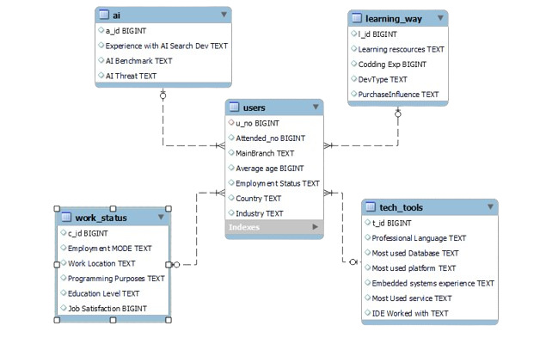
Entity-Relationship Diagram (ERD)
Dorna Raj Gyawali

Slide 5
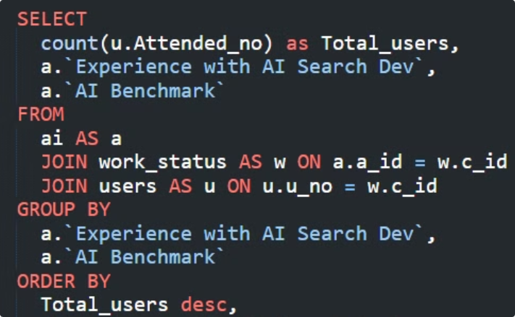
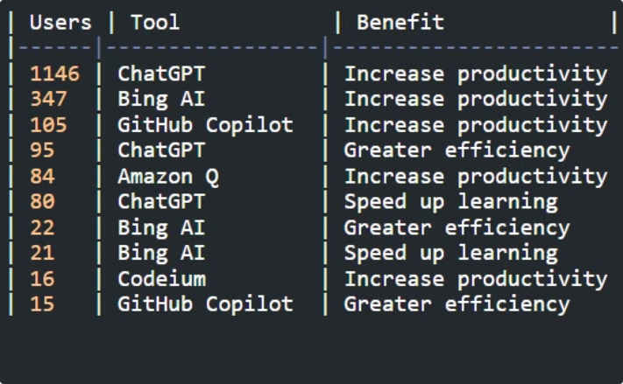
AI Adoption and Its Impact:
MySQL/Query
Result
ChatGPT ranks highest in user engagement and productivity, highlighting its effectiveness and versatility.
Dorna Raj Gyawali

Slide 6
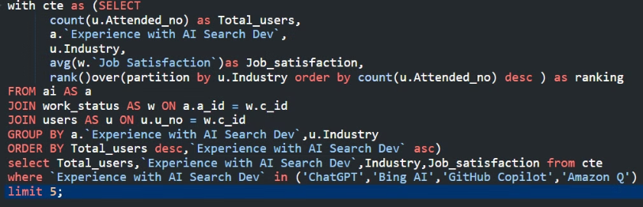
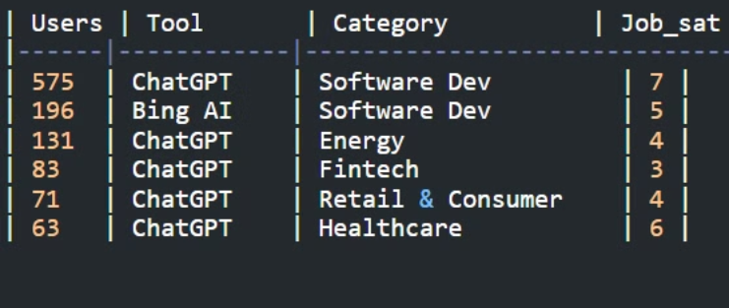
AI Tools and Job Satisfaction
MySQL/Query
Result
Almost in every Industry ChatGPT has its dominance.
Dorna Raj Gyawali

Slide 7
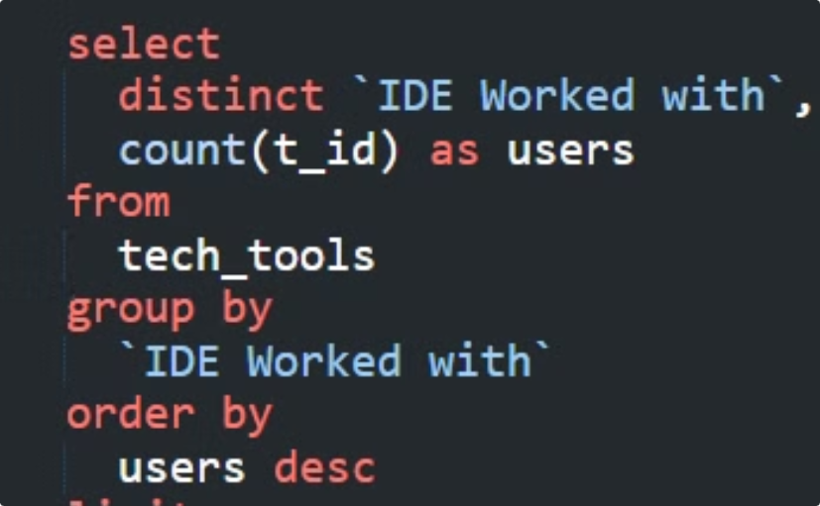
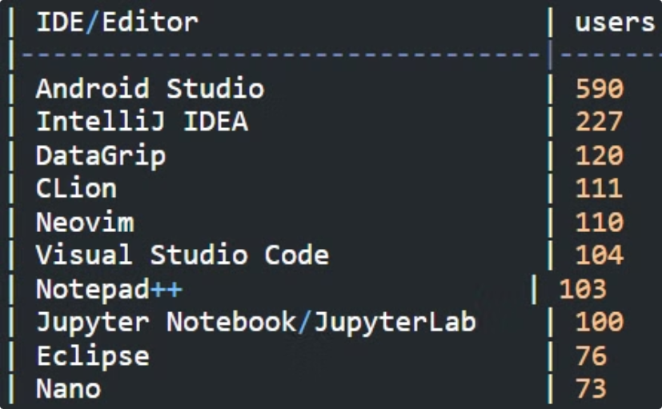
Most Used IDE/Editor
MySQL/Query
Result
The most widely used IDE/editor among users is Android Studio, while Nano is the least used.
Dorna Raj Gyawali

Slide 8
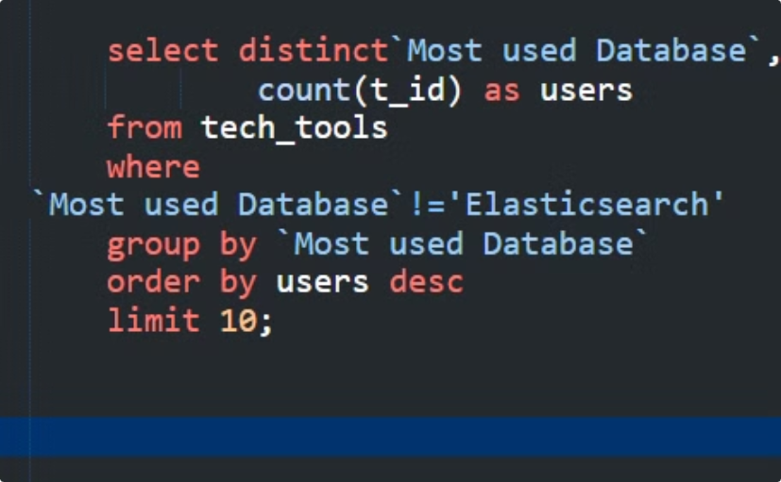
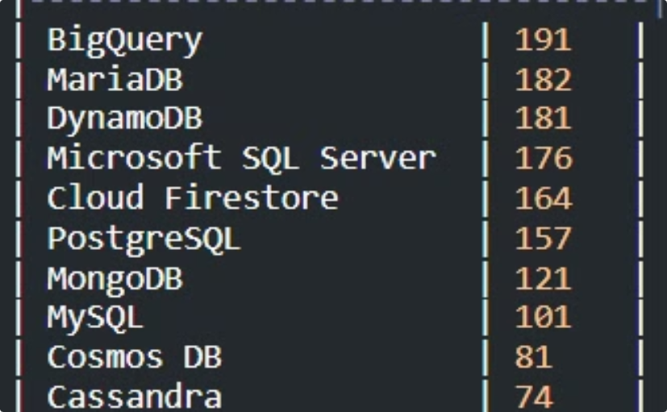
Most used Database Management Systems
MySQL/Query
Result
The most commonly used DMS is BigQuery, while Cassandra is the least used.
Dorna Raj Gyawali

Slide 9
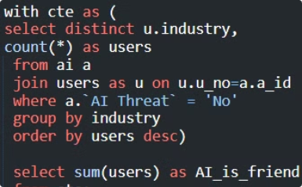
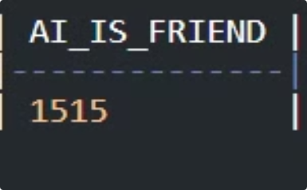
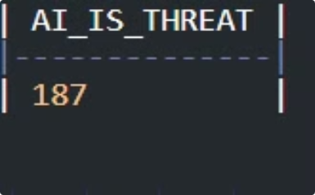
AI Threat / AI Friend
MySQL/Query
Result
A total of 1,515 users view AI as a friend, while the remaining 187 users consider AI a threat.
Dorna Raj Gyawali

Slide 10
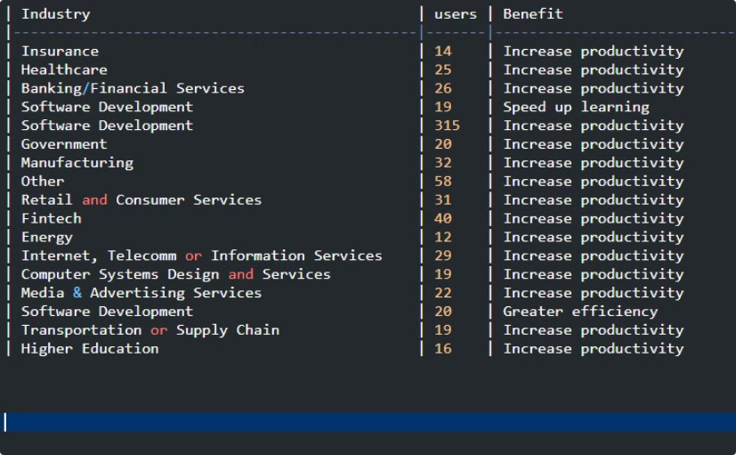
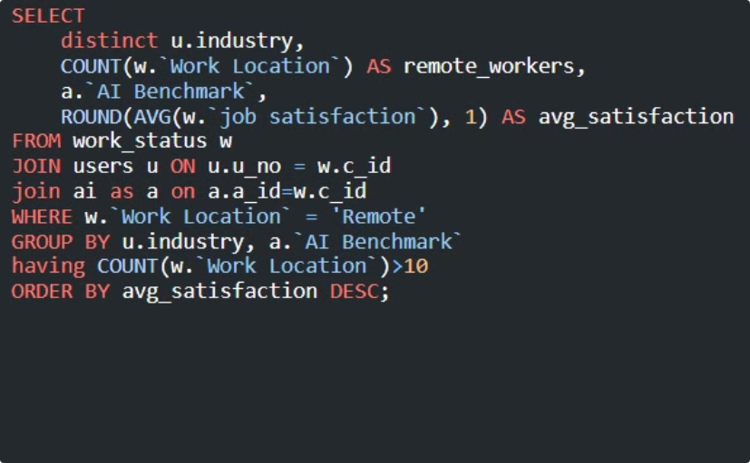
Industry Adoption of Remote Works and Job Satisfaction
Result
MySQL/Query
The highest number of remote workers comes from software companies, but employees in insurance companies have reported the highest job satisfaction among remote workers.
Dorna Raj Gyawali

Slide 11
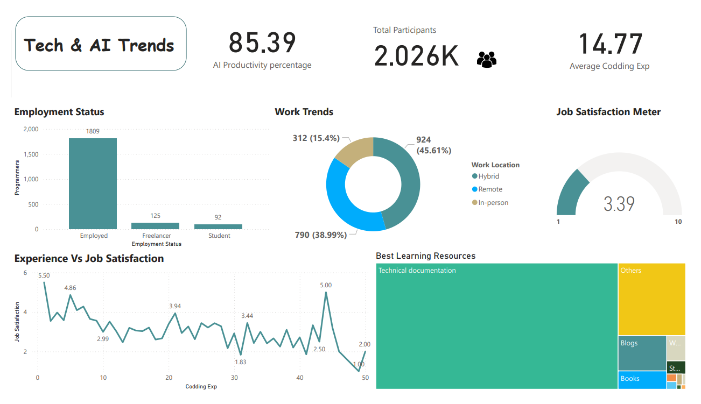

Slide 12
Thank you for Watching

